Slide 1
Resonant Circuits and Soft Switching (LLC Resonant Converter and Resonant Inverter)
TOSHIBA – Application Note

Slide 2
Table of Contents
Resonant Circuits
Soft switching (for reducing switching losses and switching noise)
1. Applications of soft switching
2. Soft switching circuit topology
3. ZVS inverter operation (Turn-off and Turn-on operation)
LLC resonant converter
1. Overview of basic primary-side operation of the LLC resonant converter
2. Detailed description of the LLC resonant converter operation (All operating modes)
3. Controlling the output voltage of the LLC resonant converter
a. Calculating equivalent load resistance and Input-output voltage ratio
b. Primary-side current of the LLC resonant converter
c. Frequency and load of the LLC resonant converter (different cases)
Resonant Inverters
1. Induction heating
2. Discharge tube drive

Slide 3
Resonant Circuits

Slide 4
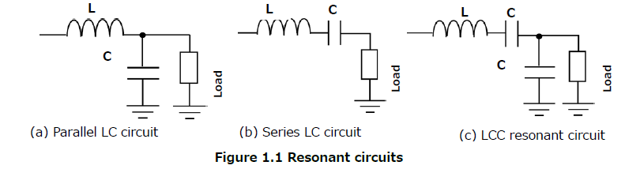
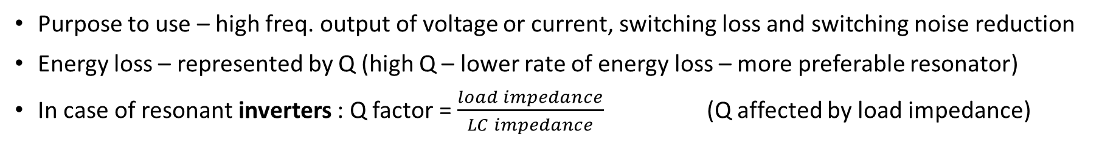
Resonant Circuits
Purpose to use – high freq. output of voltage or current, switching loss and switching noise reduction
Energy loss – represented by Q (high Q – lower rate of energy loss – more preferable resonator)
In case of resonant inverters : Q factor = $\frac{load impedance}{LC impedance}$ (Q affected by load impedance)
Goes in resonance properly,
when load has large impedance
when load has small impedance
Independent of the load impedance

Slide 5
Soft Switching

Slide 6
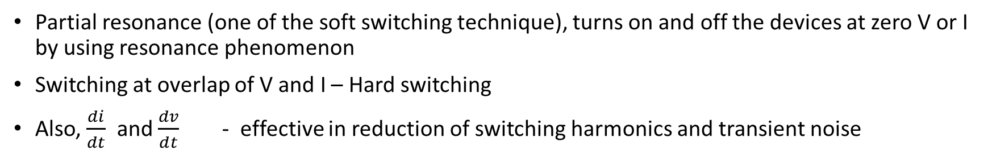
Soft switching
ZVS ZCS
Partial resonance (one of the soft switching technique), turns on and off the devices at zero V or I by using resonance phenomenon
Switching at overlap of V and I – Hard switching
Also, $\frac{di}{dt}$ and $\frac{dv}{dt}$ - effective in reduction of switching harmonics and transient noise
Applications of soft switching
Used for SMPS. Also helps reduce T/f leakage inductance loss and diode recovery loss
Disadvantage : increase in parts count (can be compensated by leakage of the T/f) and a need for more complicated control
Soft switching circuit topology
ZVS : Connect C1 and C2 in parallel with devices, resonating with load and other inductances
ZCS : Connect L1 and L2 in series with devices, resonating with load and other capacitance

Slide 7
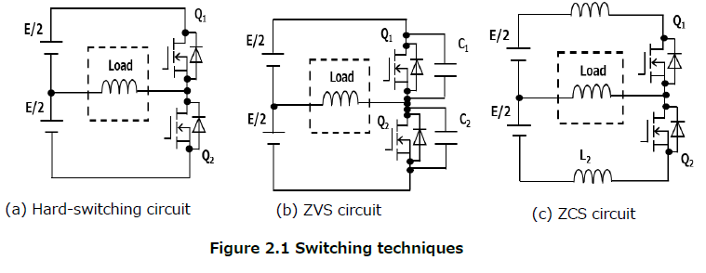
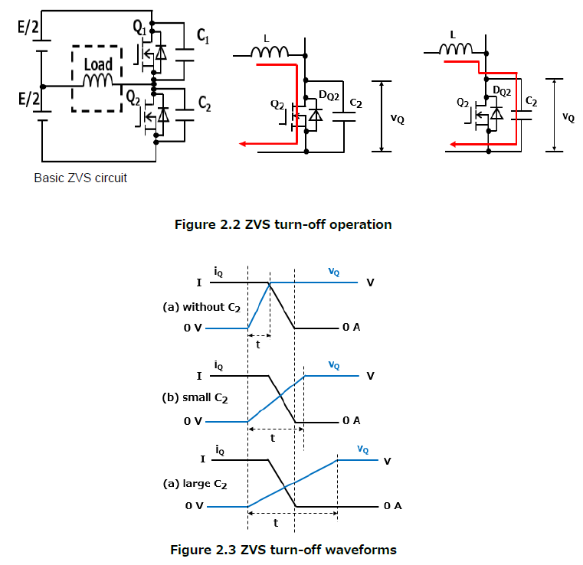
Soft-switching topology
After
turn off
ZVS inverter operation
Turn-off operation:
C1 and C2 : sums of parasitic and external capacitance of Q1 and Q2
Both rise and fall at same time
Voltage rise slope : steep
No effect on current fall in both cases
First: voltage rise,
Later: current fall
Voltage rise slope : shallow

Slide 8
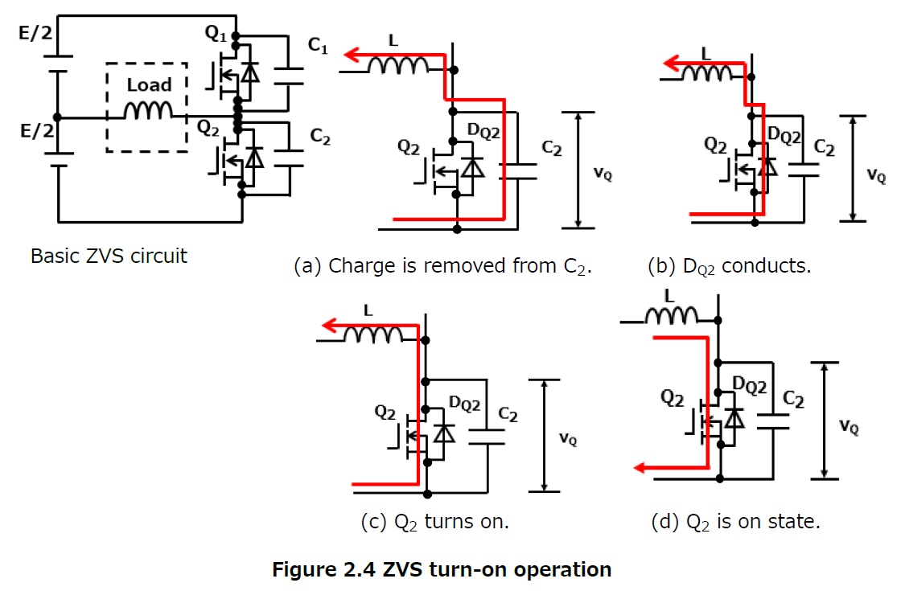
Turn-on operation:
Initially Q1 : On, Q2 : Off
First Q1 turns off – then Q2 turns on immediately (but charge still remains in capacitor C2)
To achieve soft-switching – first remove the charge
from C2 to allow diode DQ2 to conduct (VQ = VF), then turn on Q2
Charge is removed
Q1 is turned off.
Energy stored in L – used to remove charge from Q2
DQ2 conducts
When charge is completely removed from C2 – current passes through DQ2
Q2 turned on
Q2 turned on while DQ2 is conducting
Since VQ is nearly 0V at this time, ZVS occurs
On state
When energy stored in L is released, current passing through Q2 reverses its direction, putting Q2 back in On state.
At this time, Q2 is On, its voltage (VQ) is nearly 0V. Q2 achieve ZVS

Slide 9
LLC resonant converter

Slide 10
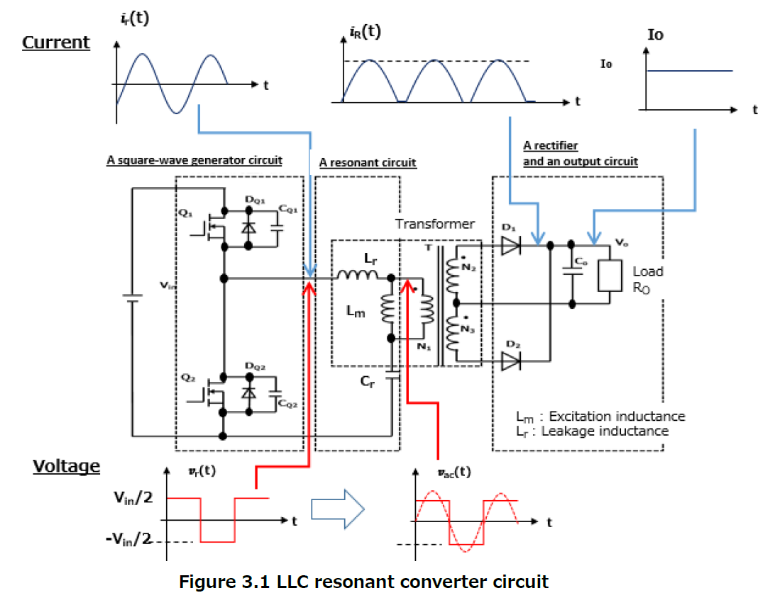
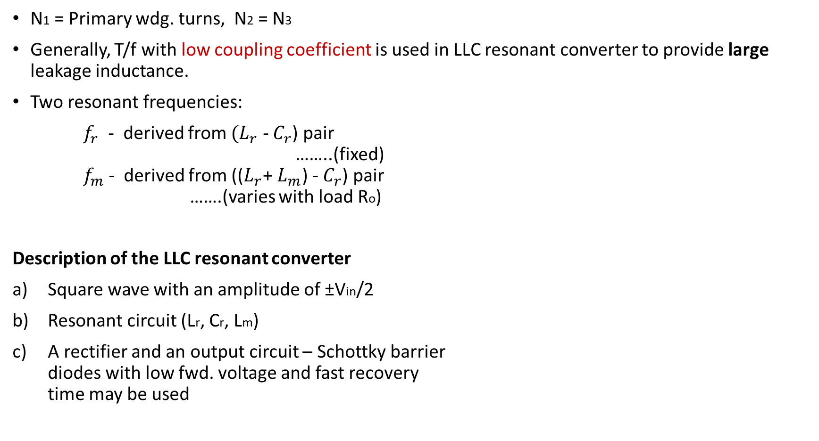
LLC resonant converter (Half bridge)
N1 = Primary wdg. turns, N2 = N3
Generally, T/f with low coupling coefficient is used in LLC resonant converter to provide large leakage inductance.
Two resonant frequencies:
$f_{r}$ - derived from $(L_{r}$ - $C_{r}$) pair ……..(fixed) $f_{m}$ - derived from (($L_{r}$+ $L_{m}$) - $C_{r}$) pair …….(varies with load Ro)
Description of the LLC resonant converter
Square wave with an amplitude of ±Vin/2
Resonant circuit (Lr, Cr, Lm)
A rectifier and an output circuit – Schottky barrier diodes with low fwd. voltage and fast recovery time may be used

Slide 11
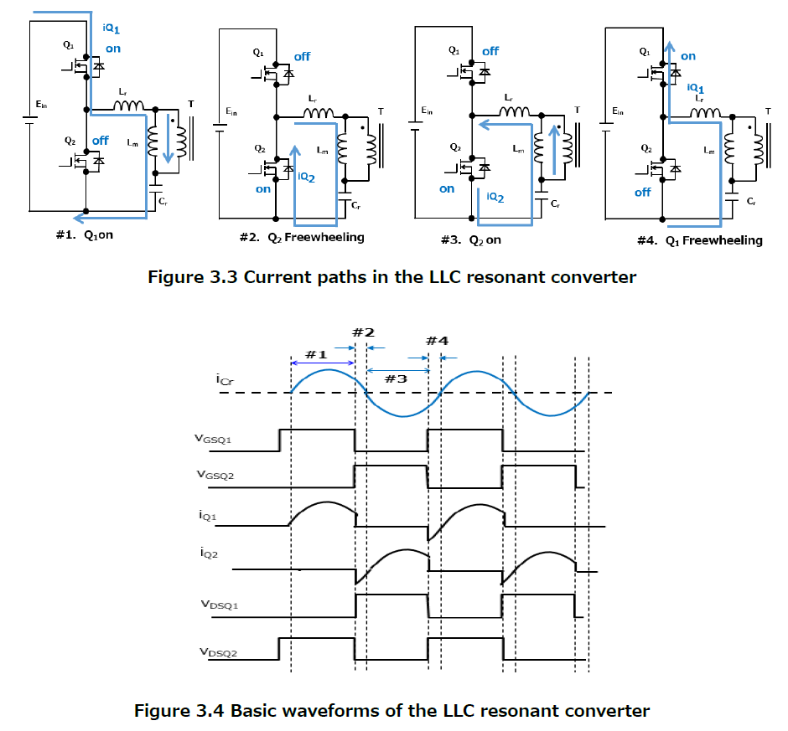
Overview of basic primary-side operation of LLC converter
Steps of operation:
Q1 turns on, passing iQ1
When Q1 turns off – current iQ2 flows through DQ2 (in reverse dir^{n}). - Q2 is turned on while the current is flowing through DQ2.
When capacitor current (iCr) changes its direction (because of LC resonance) from positive to negative – iQ2 flows through Q2 in positive direction
When Q2 is turned off while iQ2 is positive, iQ1 flows through DQ1 in reverse direction. - Q1 is turned on while the current is flowing through DQ1.
At step 2, current is passed through body diode of Q2, then Q2 is turned on when its voltage has reached almost zero (ZVS).
Likewise Q1 achieves ZVS at step 4.

Slide 12
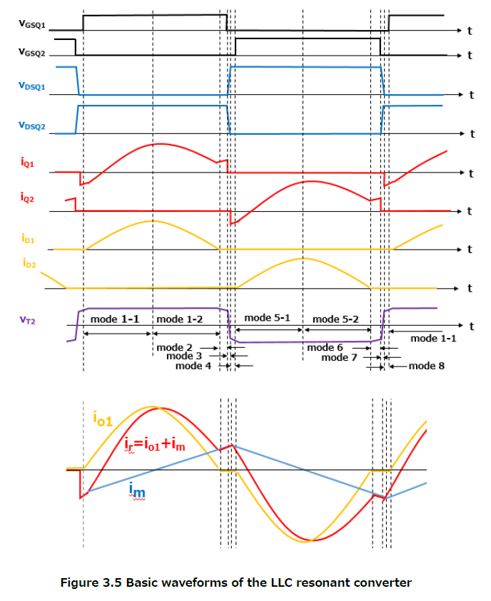
Detailed description of operation

Slide 13
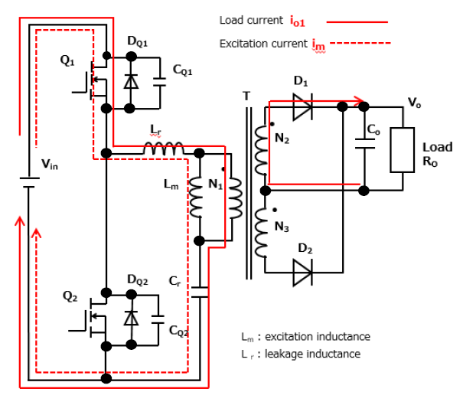
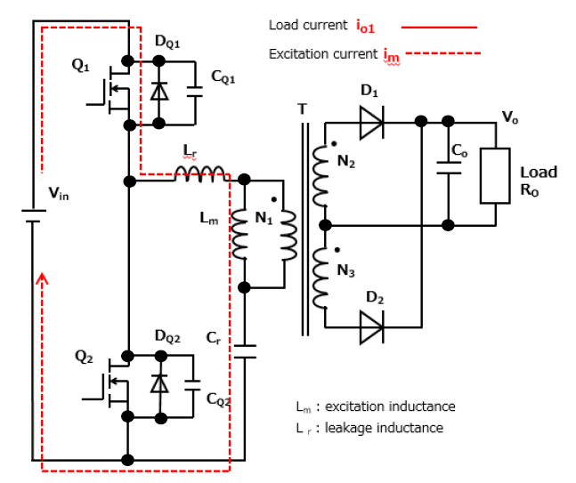
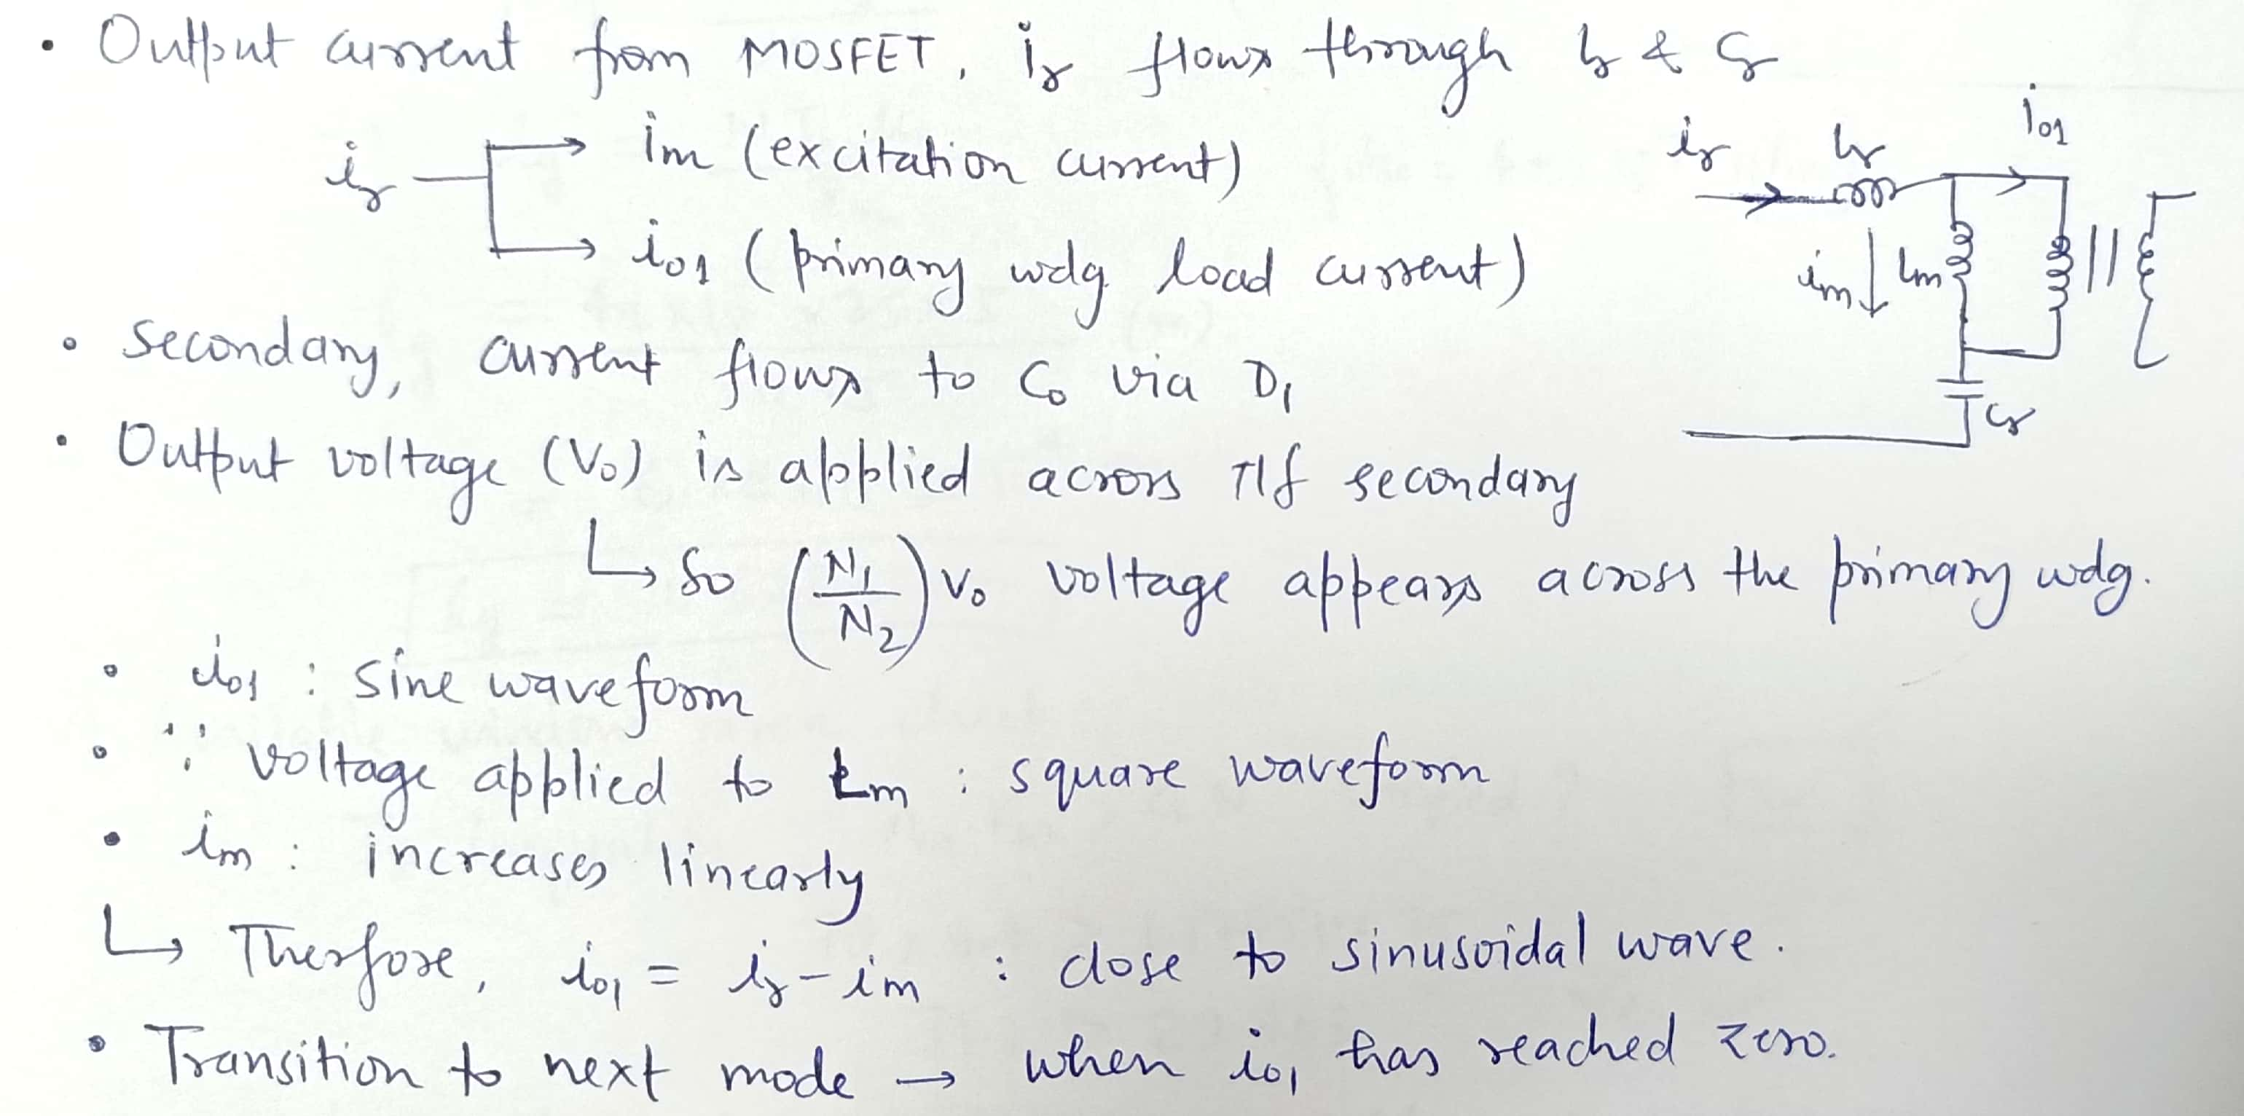
Operating mode 1-2 : (Q1 on, Q2 off)
Operating mode 2 : (Q1 on, Q2 off)

Slide 14
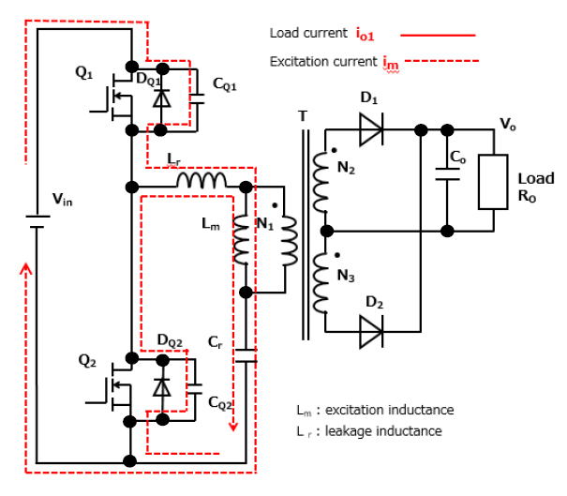
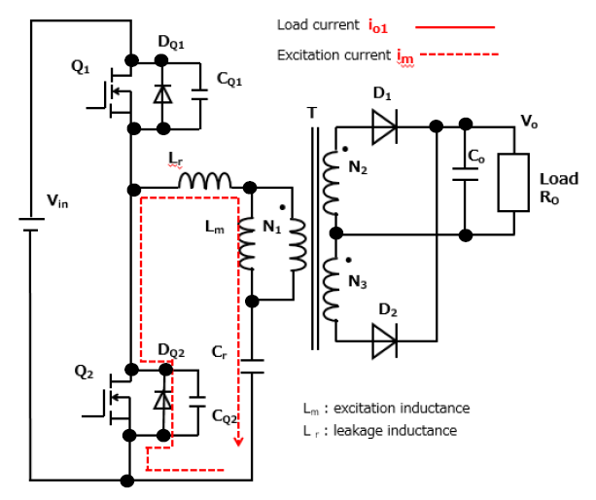
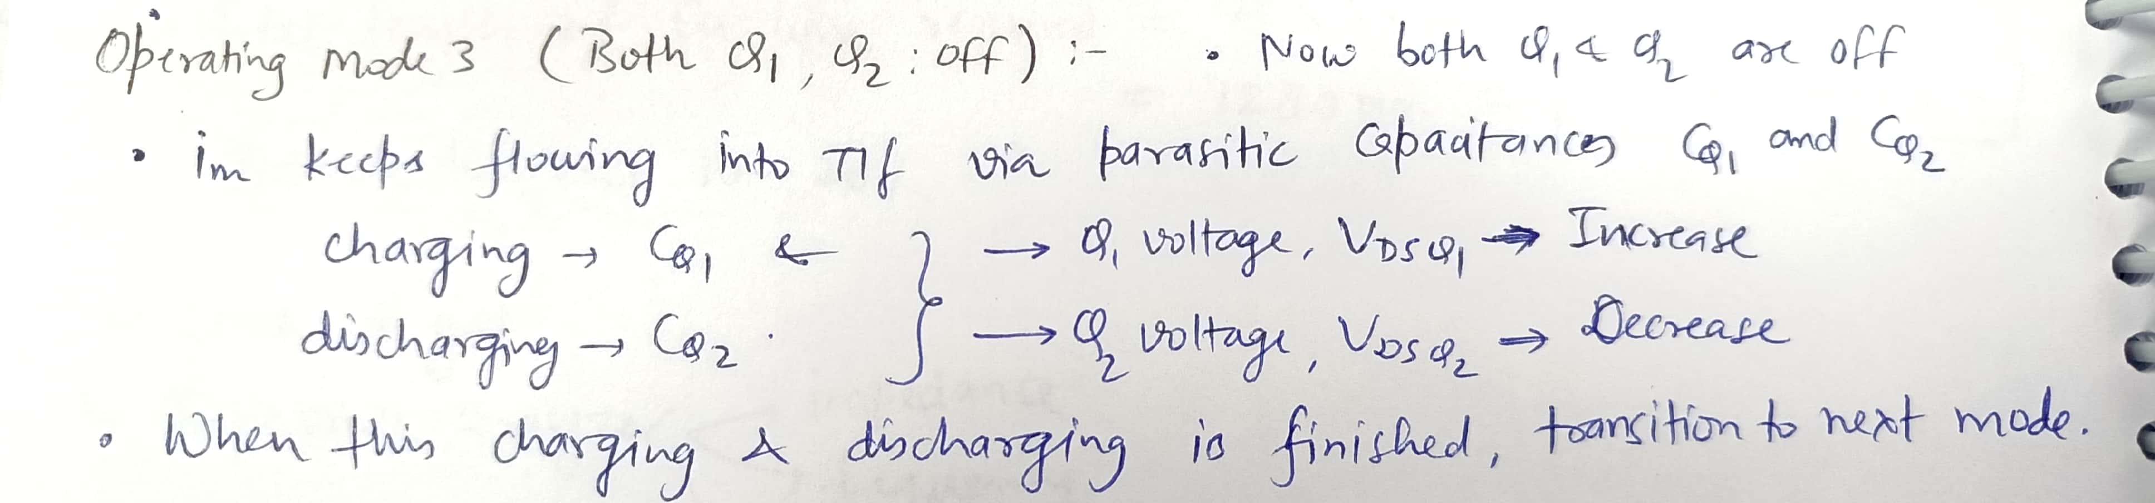
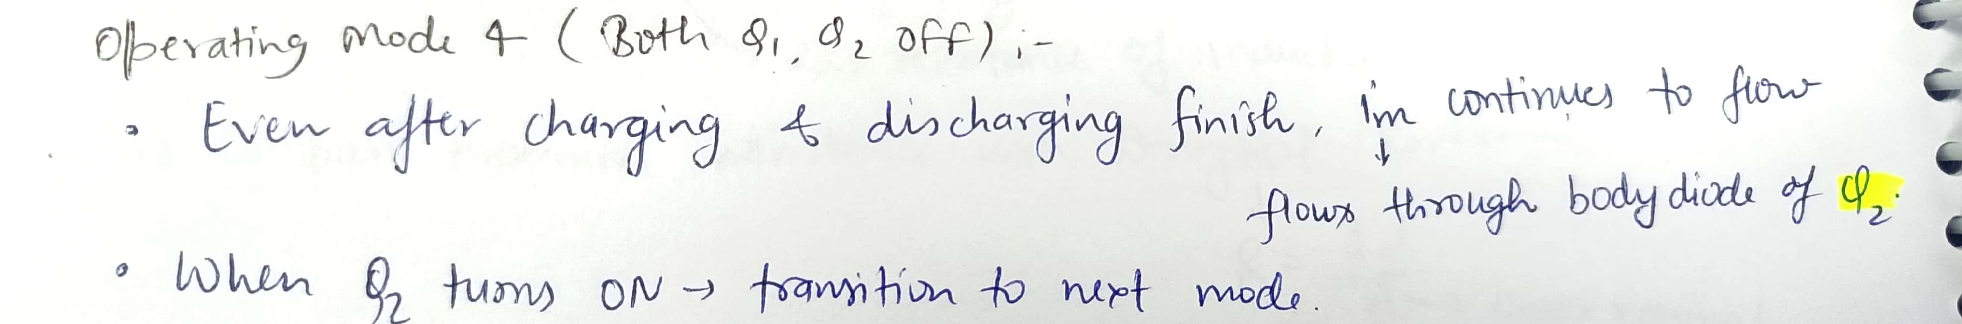
Operating mode 3 : (Both Q1, Q2 off)
Operating mode 4 : (Both Q1, Q2 off)

Slide 15
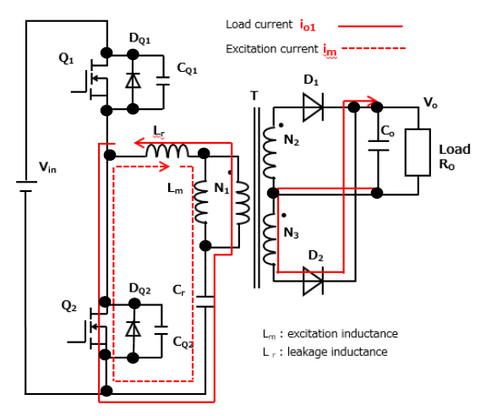
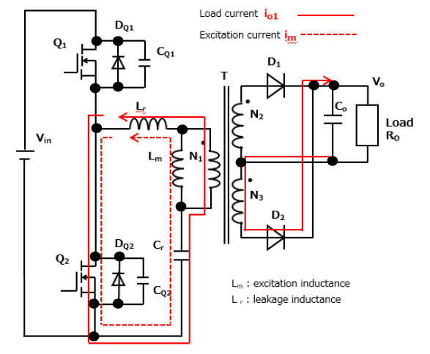
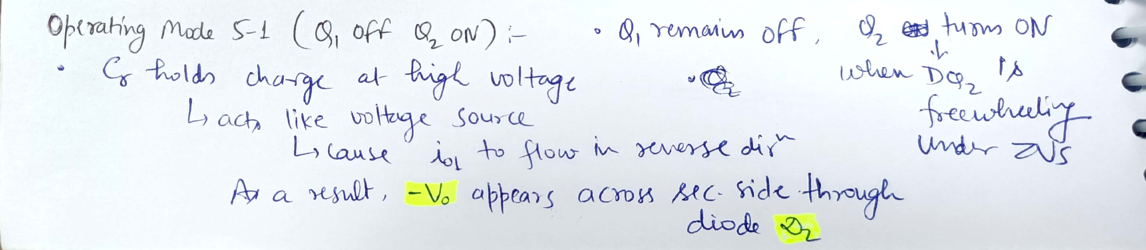
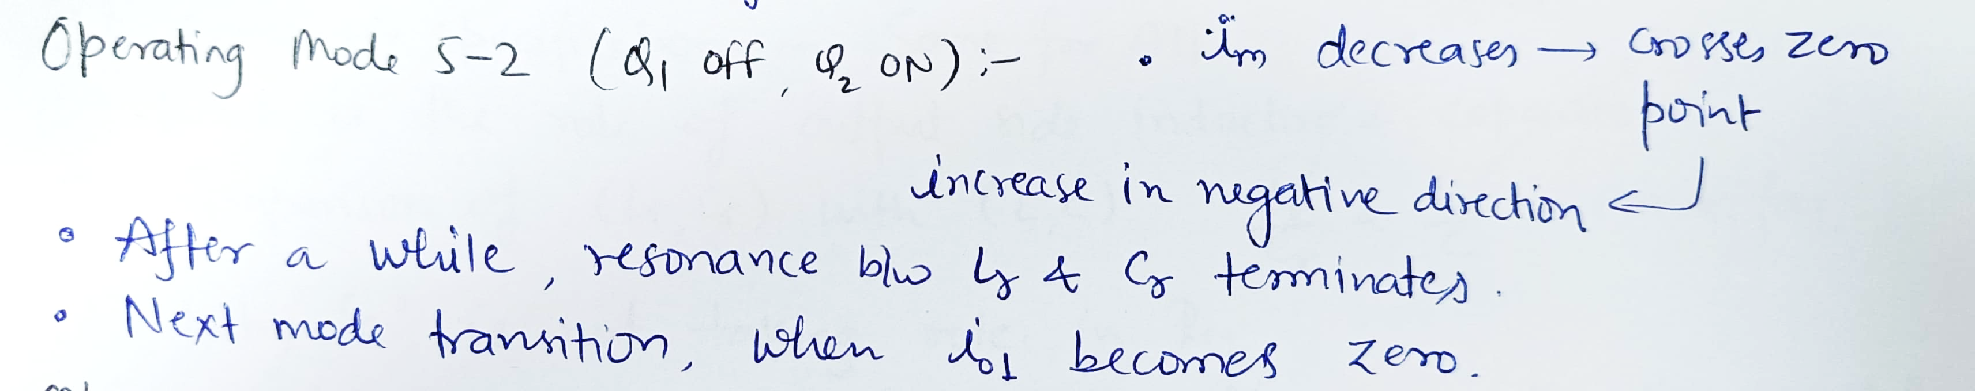

Operating mode 5-1 : (Q1 off, Q2 on)
Operating mode 5-2 : (Q1 off, Q2 on)

Slide 16
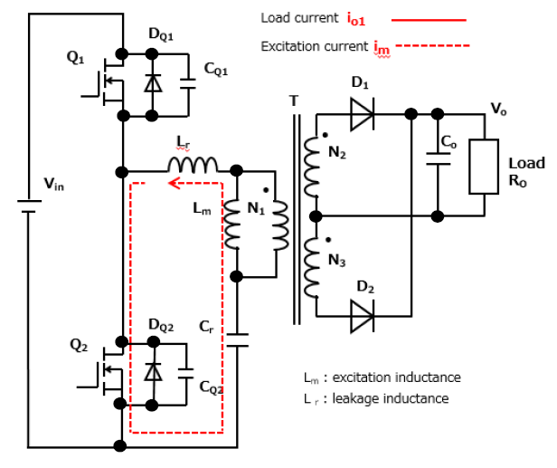
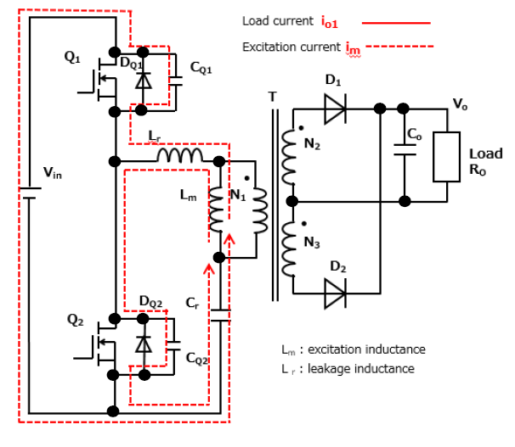
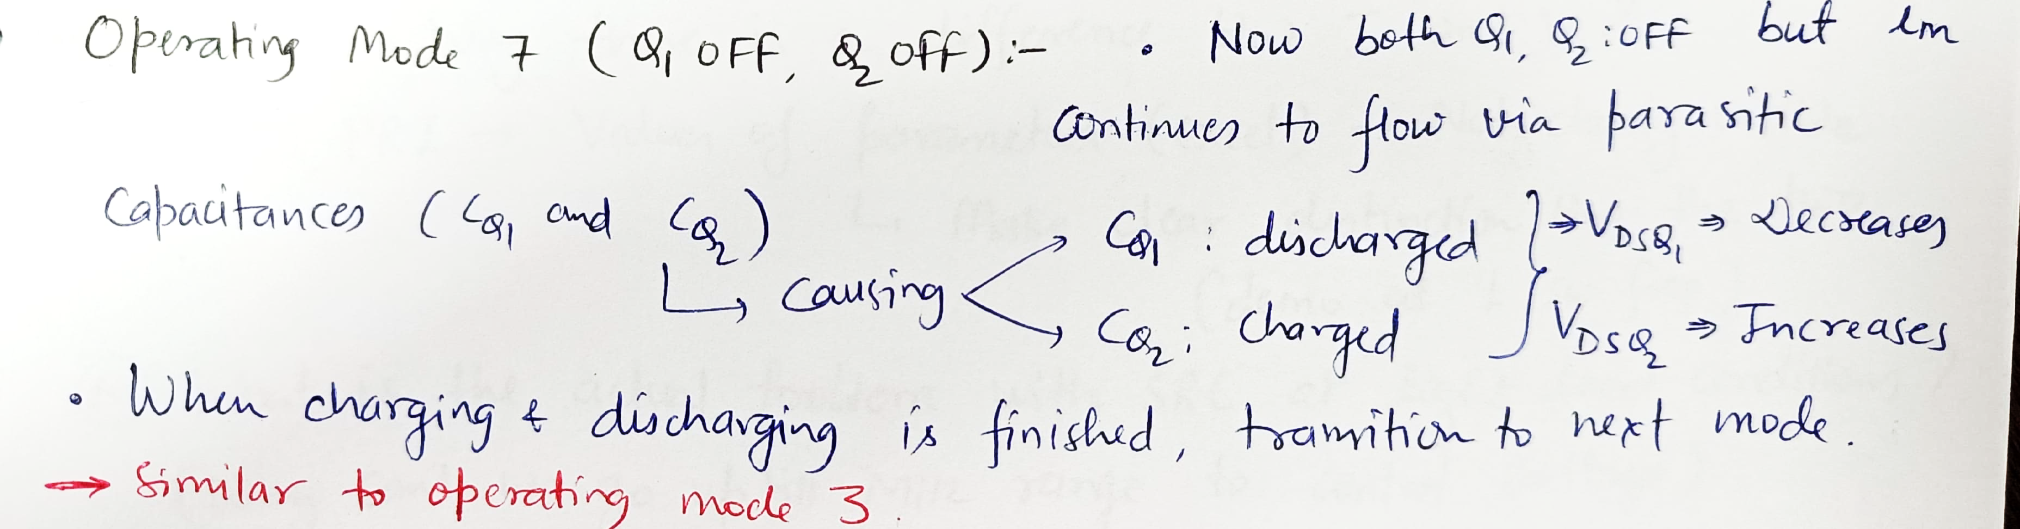
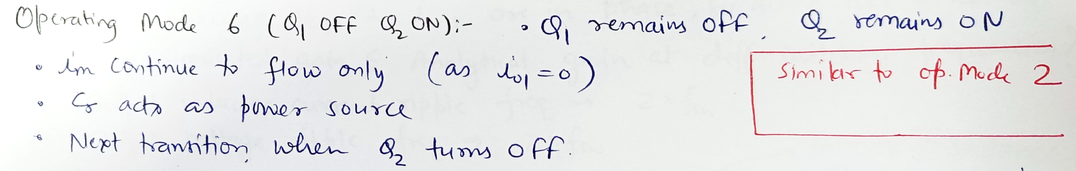
Operating mode 6 : (Q1 off, Q2 on)
Operating mode 7 : (Q1 off, Q2 off)

Slide 17
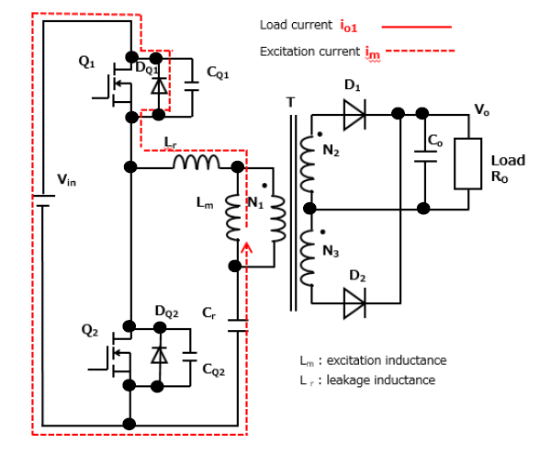
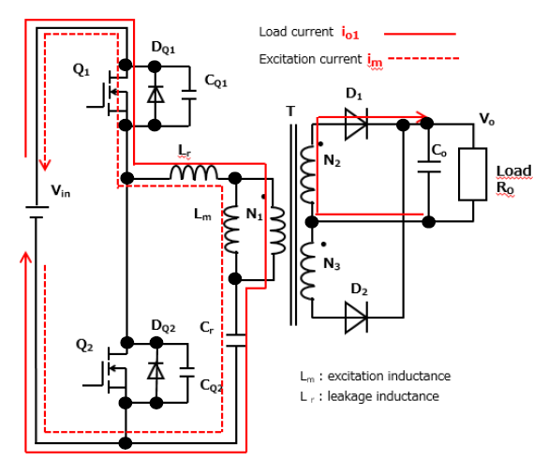
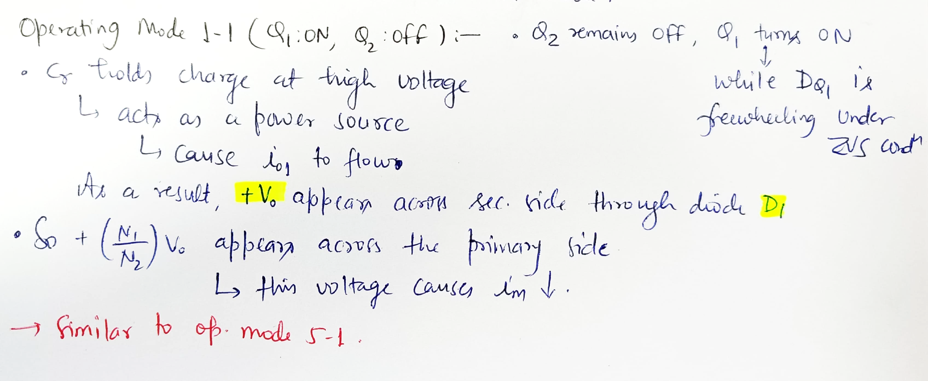
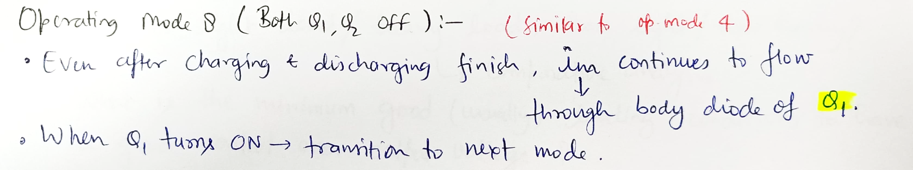
Operating mode 8 : (Both Q1, Q2 off)
Operating mode 1-1 : (Q1 on, Q2 off)

Slide 18
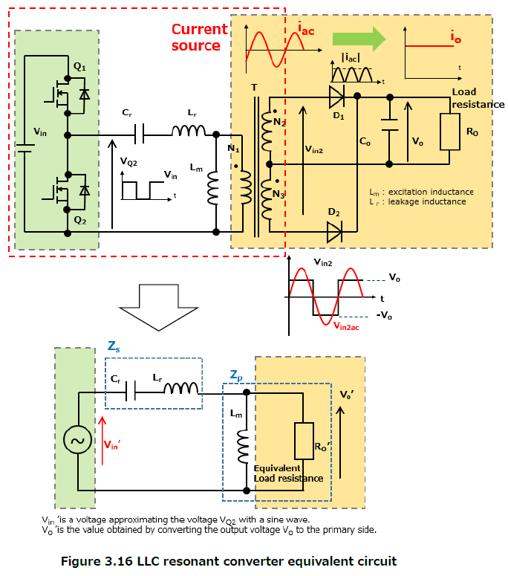
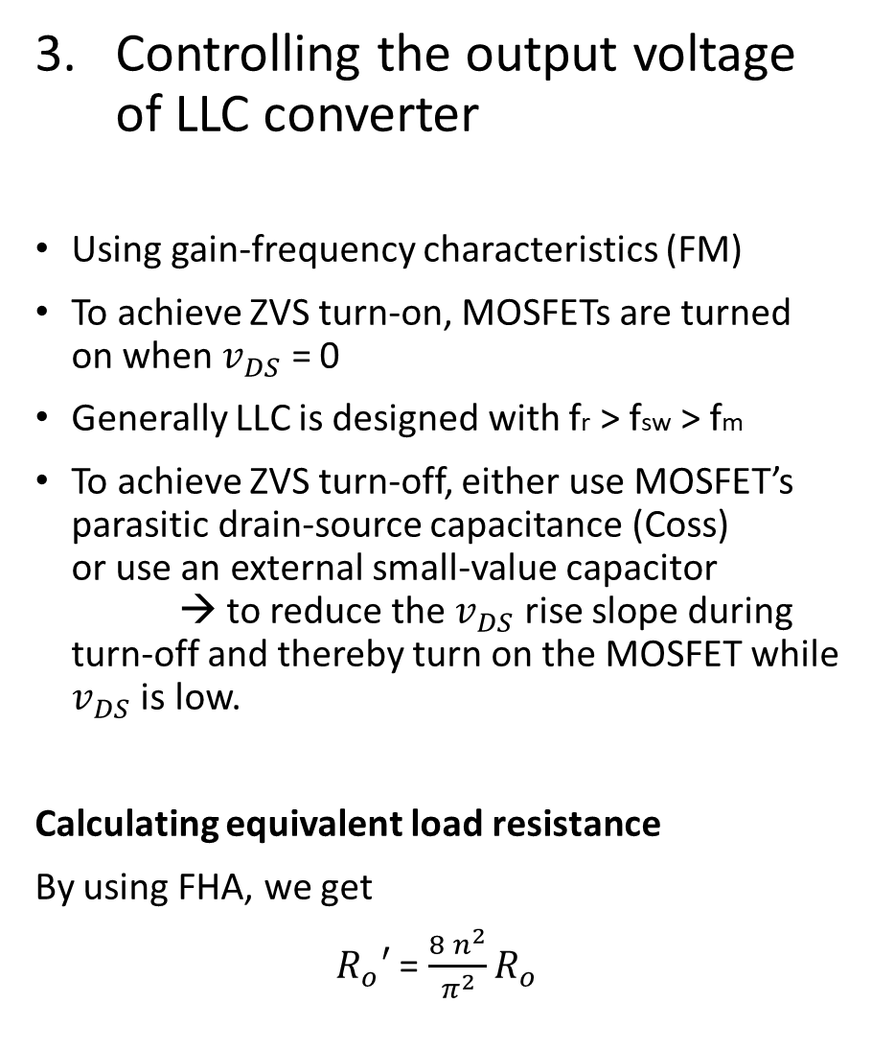
Controlling the output voltage of LLC converter
Using gain-frequency characteristics (FM)
To achieve ZVS turn-on, MOSFETs are turned on when $v_{DS}$ = 0
Generally LLC is designed with fr > fsw > fm
To achieve ZVS turn-off, either use MOSFET’s parasitic drain-source capacitance (Coss) or use an external small-value capacitor → to reduce the $v_{DS}$ rise slope during turn-off and thereby turn on the MOSFET while $v_{DS}$ is low.
Calculating equivalent load resistance
By using FHA, we get
$R_{o}′$ = $\frac{8 n^{2}}{π^{2}}R_{o}$

Slide 19
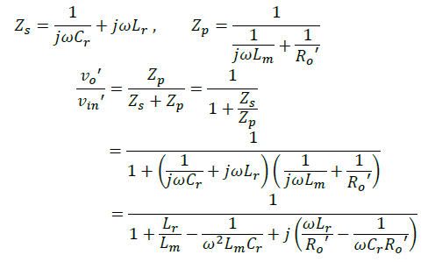
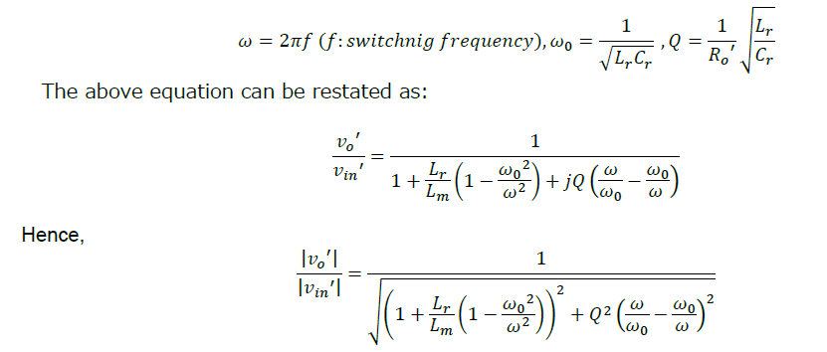
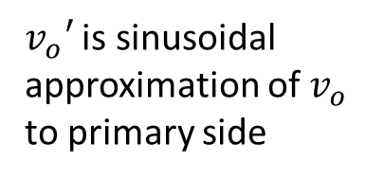
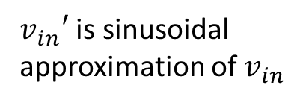
Input / output voltage ratio or gain
$v_{in}′$ is sinusoidal approximation of $v_{in}$
$v_{o}′$ is sinusoidal approximation of $v_{o}$ to primary side

Slide 20
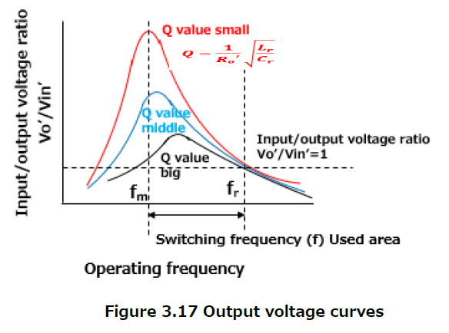
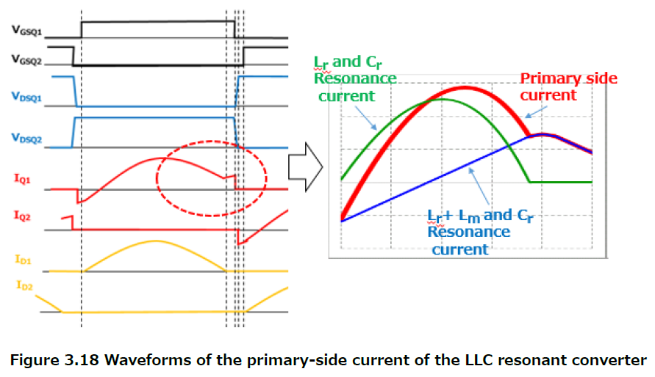
LLC converter exhibits capacitive operation below the freq. at which it provides maximum voltage gain.
- In this freq. region the upper and lower MOSFETs are SC.
It is also not operated at fs > fr : because of large freq. variation is required even for slight change in voltage
When f = fr : Cr and Lr in series resonance. : Gain = 1 (independent of load)
When fm < f < fr : Output voltage under heavy load
When f approaches fm : Output voltage (because Lm voltage is applied to T/f) : (Lm + Lr) and Cr in series resonance
Primary-side current of the LLC resonant converter
The current on primary side consists of
current through Lr current through Lm

Slide 21
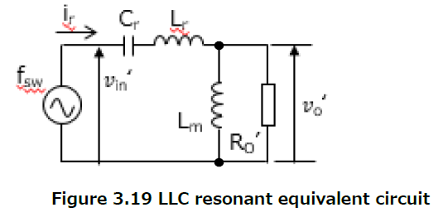
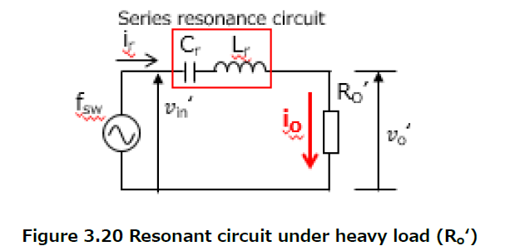
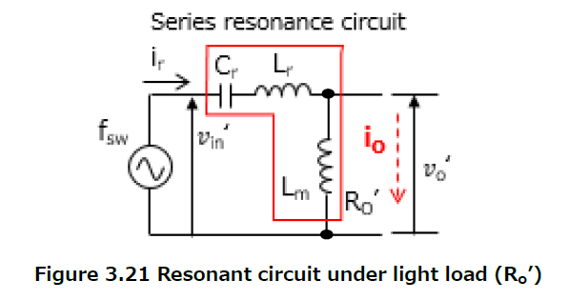
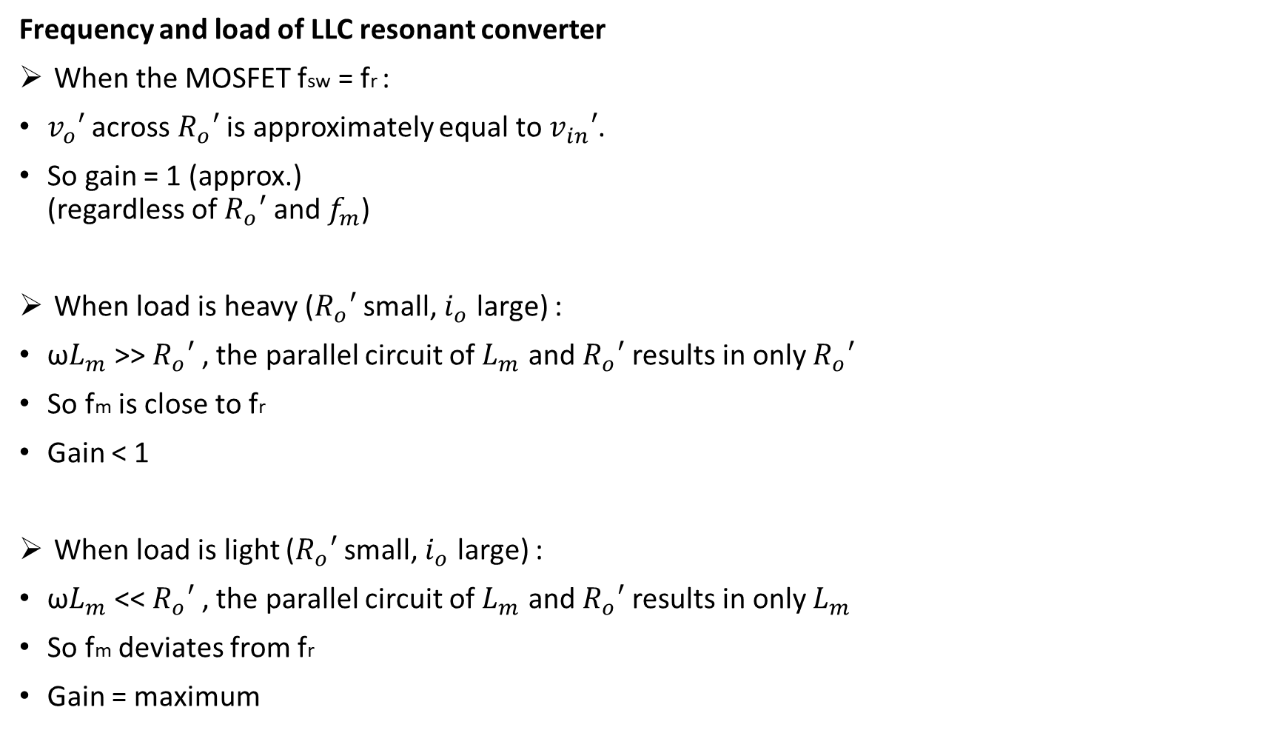
Frequency and load of LLC resonant converter
When the MOSFET fsw = fr :
$v_{o}′$ across $R_{o}′$ is approximately equal to $v_{in}′$.
So gain = 1 (approx.) (regardless of $R_{o}′$ and $f_{m}$)
When load is heavy ($R_{o}′$ small, $i_{o}$ large) :
ω$L_{m}$ >> $R_{o}′$ , the parallel circuit of $L_{m}$ and $R_{o}′$ results in only $R_{o}′$
So fm is close to fr
Gain < 1
When load is light ($R_{o}′$ small, $i_{o}$ large) :
ω$L_{m}$ << $R_{o}′$ , the parallel circuit of $L_{m}$ and $R_{o}′$ results in only $L_{m}$
So fm deviates from fr
Gain = maximum

Slide 22
Resonant inverters (from induction heating and discharge tube drive)
Skipped for now

